Slide 1
Roadmap for the year 2022 -23 Rotary Club , Hubli
Arrvvind Kubsad Vasant bhasme President Secretary

Slide 2
AROGYA VAHINI – A mobile van primarily for health check-ups at rural areas by Karnataka Cancer Therapy and Research Institute. Specifically to help early detection of Cancer so that treatment and recovery is faster. Project cost estimated about 120 lakhs

Slide 3
SHALBY KNEE SURGERIES – Rotary club Hubli has entered into a Memorandum of Understanding with Shalby Hospitals Ahmedabad. They have agreed to conduct check-up camps in Hubli and identify the Patients who have to undergo surgery . Subsequently the interested patients who approach the club for surgery, the Club based on MOU will send the patients in batches of 5-10 for undergoing the surgery. Though the surgery costs about Rs 2.5 lakhs , the cost to be borne by the patients will only be Rs 1.50 lakhs. Estimated patients to be treated under this scheme is about 100 nos.

Slide 4
HAPPY SCHOOLS –
Rotary club of Hubli, has already improved the infrastructure of almost 7 schools (Govt Schools) wherein the basic facilities, like toilet -separately for boys and girls-are provided, Hand wash facilities, clean drinking water, desks, clean environment, fully painted, compounded premises are provided.
Along with the infrastructure the teachers are provided with the green boards and Audio-Visual teaching facilities.
During the year 23-24 it is proposed to take up at least three schools for converting them into HAPPY SCHOOLs so that the children of underprivileged are given equal opportunities to learn.

Slide 5
TREE PLANTATIONS – The Club has always believed that protecting the environment is the only way forward to climate change. Towards this end it has planted about 500 plants along the Gokul road-Airport-Tarihal bye-pass which have now grown tall. During the year 23-24, the same stretch in the median is proposed to be taken up and plantation of about 600 trees are planned.

Slide 6
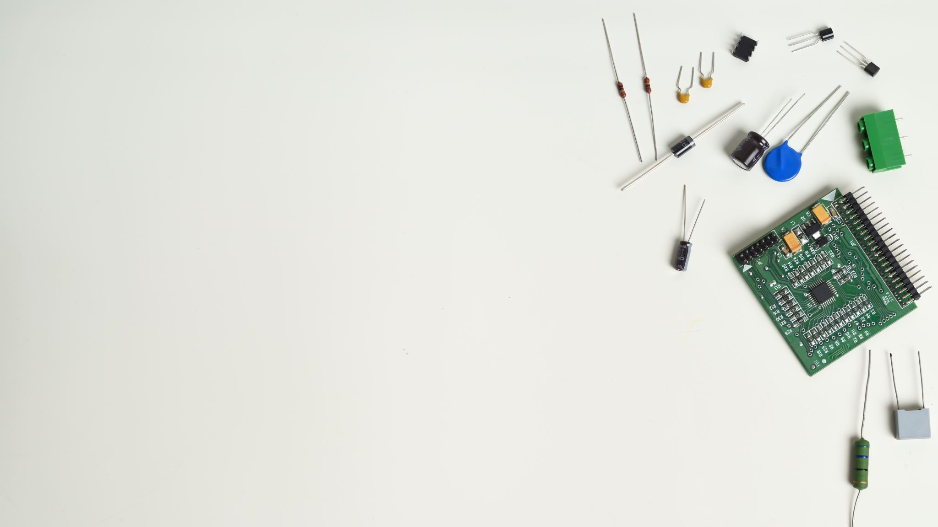
VOCATIONAL TRAINING FOR UNSKILLED - Training the unskilled workers in the trade for 1-Electrician 2-Plumber 3-Painter 4-Tile fitter 5-Tailoring/fashion design To engage all workers through the respective trade associations for the training them in their skills, involving the brands in the respective trades which will benefit both the trainees and the brands to sell the products. The impact of this would be to the public and the consumers who will get the service/s of trained workers for execution of the works.

Slide 7
ROTARACT AND INTERACT CLUBS – To build leadership qualities at an early age, Rotary has Clubs at school and college levels. Presently the Club has sponsored 2 interact and 2 Rotract Clubs. During the year it already has had discussions with educational institutions whereby at least 4 Interact and 4 Rotract Clubs would be newly formed and the existing ones would be rejuvenated by involving them in the activities of the club.

Slide 8
WOMEN EMPOWERMENT -
In association with a Company which manufactures Sewing Machines it is proposed to provide training to Women in fashion design, tailoring etc.
At the end of training period, these women would be provided sewing machines at a nominal cost of 2500/- and also provide guidance to stich those items which are in demand and Rotary also assists and ensures that the stiched items are sold in the market at a reasonable price.
The women would be self sufficient and can also progress by acquiring new skills.

Slide 9
SCHOLARSHIPS TO MERITORIUS STUDENTS AND ECONOMICALLY BACKWARD: About 100 students are awarded scholarships based on their merit and economic background. BLOOD DONATIONS: About 1000 units of Blood is proposed to be collected and donated to the Blood Banks. To hold 2 camps every month at the premises of the donors. DENTAL CHECK UP: About 5000 students will be benefitted, from the dental check-up camps to be conducted throughout the year. EYE CHECK UP:About 5000 students will be benefitted, from the eye check-up camps to be conducted throughout the year. ADULT LITERACY: The students of schools and colleges would be counselled and trained to teach the adults in their localities.Target about 1000 students to teach 1000 adults. In addition, community- based literacy programme for adults will be organised.

